Slide 1

Java EE:
JavaServer Faces – Libraries, Tags and Templates
SoftUni Team
Technical Trainers
Software University
http://softuni.bg

Slide 2
Table of Contents
Libraries and Tags
Basic tags
Validation tags
Data table
Templates
Facelet tags

Slide 3
Questions
sli.do #java-web

Slide 4

JSF Libraries and Tags

Slide 5

JSF – Basic Tags(1)
JSF provides a standard HTML tag library
Tags get rendered into corresponding html output
Use the following namespaces of URI in
html node:
<html
xmlns = "http://www.w3.org/1999/xhtml" xmlns:h = "http://java.sun.com/jsf/html"
>

Slide 6
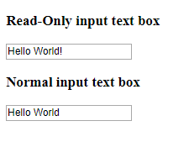
JSF – Basic Tags(2)
h:inputText:
Renders an HTML input element of the type "text"
<h:form>
<h3>Read-Only input text box</h3>
<h:inputText value = "Hello World!" readonly = "true"/>
<h3>Normal input text box</h3>
<h:inputText value = "Hello World"/>
</h:form>

Slide 7
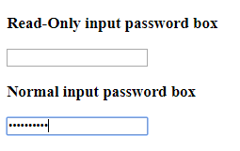
JSF – Basic Tags(3)
h:inputSecret:
Renders an HTML input element of the type "password"
<h:form>
<h3>Read-Only input password box</h3>
<h:inputSecret value = "password" readonly = "true"/>
<h3>Normal input password box</h3>
<h:inputSecret value = "password"/>
</h:form>

Slide 8
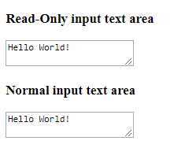
JSF – Basic Tags(4)
h:inputTextarea:
Renders an HTML input element of the type “textarea"
<h:form>
<h3>Read-Only input text area</h3>
<h:inputTextarea row = "10" col = "10" value = "Hello World!" readonly = "true"/>
<h3>Normal input text area</h3>
<h:inputTextarea value = "Hello World!"/>
</h:form>

Slide 9

JSF – Basic Tags(5)
h:inputHidden:
Renders an HTML input element of the type "hidden“
h:selectBooleanCheckbox:
Renders a single HTML check box
h:selectOneRadio:
Renders a single HTML radio button
h:selectOneMenu:
Renders an HTML input element
of the type "select"

Slide 10

JSF – Basic Tags(6)
h:outputText:
Renders an HTML text
<h:form>
<h3>Text</h3>
<h:outputText value = "Hello World"/>
</h:form>

Slide 11
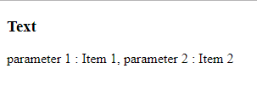
JSF – Basic Tags(7)
h:outputFormat:
Renders an HTML text but can accept parameterized inputs
<h:form>
<h3>Text</h3>
<h:outputFormat value = "parameter 1 : {0}, parameter 2 : {1}" >
<f:param value = "Item 1" />
<f:param value = "Item 2" />
</h:outputFormat>
</h:form>

Slide 12


JSF – Basic Tags(8)
h:graphicImage:
Renders an HTML element of the type "img“
h:outputStylesheet:
Renders an HTML element of the type "link" with type
"text/css“
h:outputScript:
Renders an HTML element of the type
"script" with type "text/javascript"

Slide 13

JSF – Basic Tags(8)
h:commandButton:
Renders an HTML input element of the type "submit“
h:commandLink:
Renders an HTML "anchor" element

Slide 14
JSF – Convertor Tags(1)
JSF provides inbuilt convertors
Convert UI component's data to objects
Use the following namespaces of URI in
html node:
<html
xmlns = "http://www.w3.org/1999/xhtml" xmlns:f = "http://java.sun.com/jsf/core"
>

Slide 15

JSF – Convertor Tags(2)
f:convertNumber
Convert a string value to a number of required format
Attributes:
type: number, currency, or percent
pattern: formatting pattern, as defined in
java.text.DecimalFormat

Slide 16

JSF – Convertor Tags(3)
f:convertDateTime
Convert a string value to a date of required format
Attributes:
type: date (default), time, or both
dateStyle: default, short, medium, long, or full
timeStyle: default, short, medium, long, or full
pattern: formatting pattern, as defined in
java.text.SimpleDateFormat

Slide 17

JSF – Validator Tags(1)
JSF provides inbuilt validators
Can validate:
Length of a field
Type of input which can be a custom object
f:validateLength
Used to validate the length of a string value in a particular range
Attributes:
minimum
maximum

Slide 18

JSF – Validator Tags(2)
f:validateLongRange
Used to validate the long value in a particular range
Attributes:
minimum
maximum

Slide 19

JSF – Validator Tags(3)
f:validateDoubleRange
Used to validate a value to a range of float values
Attributes:
minimum
maximum

Slide 20
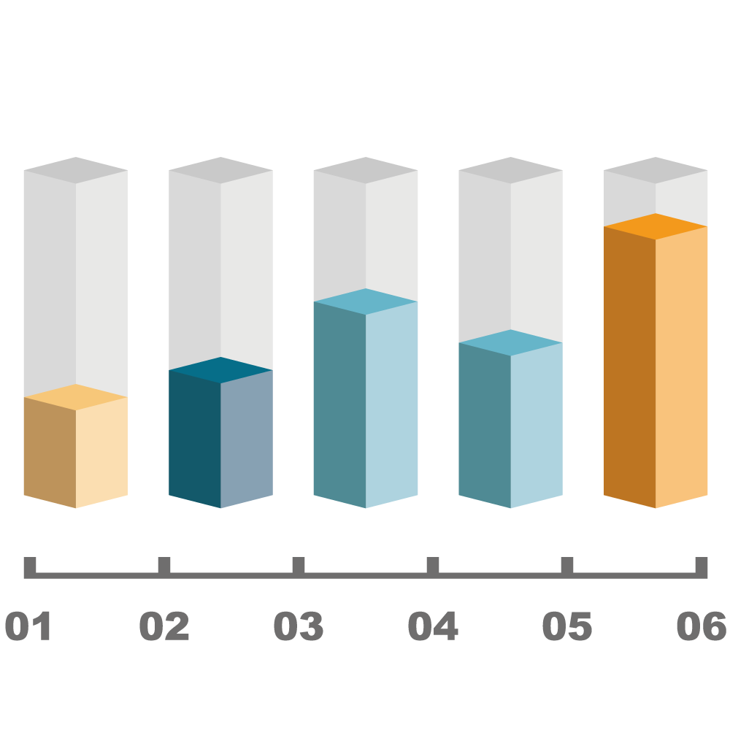
JSF DataTable
JSF provides DataTable to render and format html tables
Can iterate over a collection or array of values to display data
Provides attributes to modify its data in an easy way
h:dataTable
Used to display data in a tabular fashion
h:column
Used to display column

Slide 21

Templates

Slide 22
JSF – Facelets Tags(1)
Facelets tags
Create common layout for a web application
Provide flexibility to manage common parts of multiple pages at one place
Use the following namespaces of URI in
html node:
<html
xmlns:ui = "http://java.sun.com/jsf/facelets"
>

Slide 23

JSF – Facelets Tags(2)
Templates in a web application defines:
Common interface layouts
Styles
ui:insert
Used in template file
Defines contents to be placed in a template

Slide 24

JSF – Facelets Tags(3)
ui:define
Defines the contents to be inserted in a template
ui:include
Includes contents of one xhtml page into another xhtml
page
ui:composition
Loads a template using template attribute
Defines a group of components to be inserted in
xhtml page

Slide 25
JSF – Facelets Tags – Example(1)
Define a default content of Header section
Define a default content of Footer section
header.xhtml
<ui:composition>
<h1>Hello, I am Header</h1>
</ui:composition>
footer.xhtml
<ui:composition>
<h2>Hello, I am Footer</h2>
</ui:composition>

Slide 26

JSF – Facelets Tags – Example(2)
Define a default content of Content section
content.xhtml
<ui:composition>
<h3>Hello, I am Content</h3>
</ui:composition>

Slide 27
JSF – Facelets Tags – Example(3)
Use ui:insert and ui:include tag to include header/footer and
content file in template file
common.xhtml
<ui:insert name="header">
<ui:include src="header.xhtml" />
</ui:insert>
<ui:insert name="content">
<ui:include src="content.xhtml" />
</ui:insert>
<ui:insert name="footer">
<ui:include src="footer.xhtml" />
</ui:insert>

Slide 28
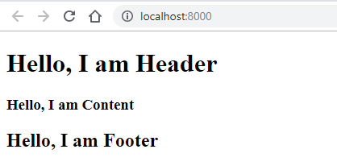
JSF – Facelets Tags – Example(4)
Load common.xhtml using ui:composition tag in any xhtml
page
index.xhtml
<h:body>
<ui:composition template="templates/common.xhtml" />
</h:body>

Slide 29

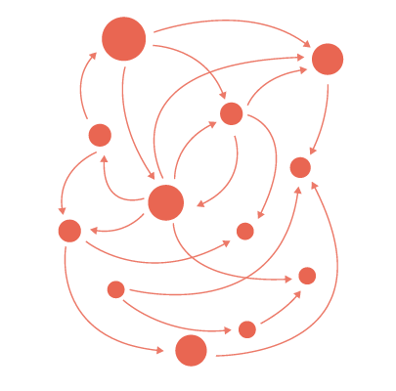



Summary
Tags:
Basic tags
Validation tags
DataTable
Templates:
Facelets tags
Provide flexibility to manage common parts of multiple pages at one place

Slide 30
https://softuni.bg/trainings/courses

Slide 31













SoftUni Diamond Partners

Slide 32




SoftUni Organizational Partners

Slide 33




Trainings @ Software University (SoftUni)
Software University – High-Quality Education and Employment Opportunities
softuni.bg
Software University Foundation
http://softuni.foundation/
Software University @ Facebook
facebook.com/SoftwareUniversity
Software University Forums
forum.softuni.bg

Slide 34

License
This course (slides, examples, demos, videos, homework, etc.) is licensed under the "Creative Commons Attribution-NonCommercial-ShareAlike 4.0 International" license

